Slide 2
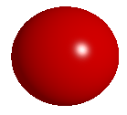
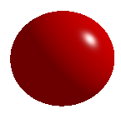
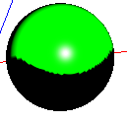
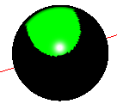
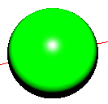
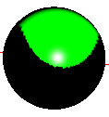
Same view point, different light direction
Some cone angle and cone direction, different position
(15.0, 0.0, 10.0)
(15.0, 10.0, 0.0)
(4.0, 0.0, 9.0) far
4.0, 0.0, 6.0) near
Some light position and cone angle, different cone direction
Some light direction and cone direction, different cone angle
(0.0, 1.0,-5.0 )
(0.0, 0.0, -9.0)
pint to the
sphere center
22 degree
16 degree

Slide 3
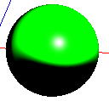
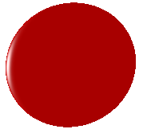
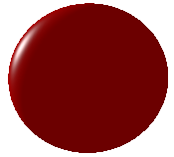
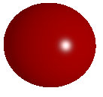
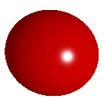
Smooth effect
Same ambient material, different ambient intensity
(without smooth)
(with smooth)
ambient intensity=0.8
ambient intensity=0.3
Same diffuse material, different diffuse intensity
Same shininess, different specular intensity
diffuse intensity=1.0
diffuse intensity=0.5
specular intensity=1.0
specular intensity =2.0

Slide 4
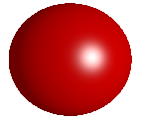
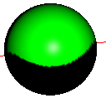
Shininess effect
Attenuation coefficient effect
shininess=70
shininess=20
Attenuation coefficient=0.01
Attenuation coefficient=0.1

